Slide 1
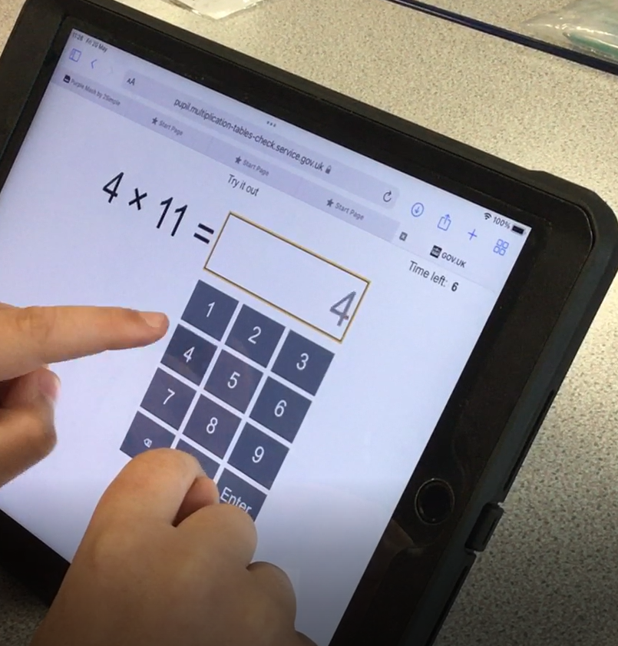
Multiplication Tables Check 2024

Slide 2
What is the MTC?
The multiplication tables check (MTC) is statutory for primary schools in the 2023/24 academic year.
The purpose of the MTC is to determine whether pupils can recall their times tables fluently up to 12, which is essential for future success in mathematics. It will help us to identify pupils who have not yet mastered their times tables, so that additional support can be provided.
We must administer the MTC to all eligible Year 4 pupils between Monday 3rd June and Friday 14th June. If required, we can administer the check the following week from Monday 17 June to Friday 21 June, for any children who were absent during the first two weeks
It is an on-screen check consisting of 25 times table questions. Children will be able to answer 3 practice questions before taking the actual check. They will then have 6 seconds to answer each question. On average, the check should take no longer than 5 minutes to complete.

Slide 4
What if your child finds times tables difficult?
We will have already spoken to you about this check and given you advice on how to support your child.
Using TT Rockstar's, wrote learning (chanting), writing tables out repeatedly or playing games will all help your child to learn their tables.
We practise tables in school daily and have done for the last few years but it is ultimately up to your child to learn them. We give them the tools and strategies of different ways to learn them and opportunities to practise.
The soundcheck tab on TT Rockstar's is the section most like the MTC check where it gives 6 seconds to answer a multiplication question up to 12. Times Tables Rock Stars: Play (ttrockstars.com). The Multiplication check section on Multiplication Tables Check - 2023 - Timestables.co.uk is also a good place to practise.
If your child cannot access the MTC check there are several access arrangements that are available to us. We can use them to support children with specific needs. The check has been designed so that it is as inclusive and accessible to as many children as possible, including those with Special educational needs (SEND) and English as an additional language (EAL). However in some circumstances it may not be appropriate for a pupil to take the check even with access arrangements. We will have discussed this with you if this is the case and if you have any concerns you can speak to us.

Slide 5
What do you need to do to support your child for the check?
You do not need to do anything over and above to prepare your child for the actual check. As part of usual practice, we ask you to practise times tables with your child through the various ways mentioned before.
Useful resources:
TT Rockstars (school subscription, your child has their own password)
Hit the button (free on the internet)
Timetables.co.uk (free on the internet)
Supermoves on the BBC (internet)
Timetable books from the shops.
Other strategies-quick fire recall, writing them out, chanting the tables in different ways,….

Slide 6
How will the results be used and feedback given?
We will have access to the children’s results from Monday June 24th. Once we have these you will be given your child’s score, as with all national curriculum assessments and this will be through your child’s report. We may also decide to tell the children individually as well before their report.
There is no pass mark for the check. Children are expected to get 25 out of 25 correct to show they know their tables. We are very much aware that nerves can play a part and mistakes happen and so these checks will take place in a room with no more than 6 children and they will be observed. After the check and with the results we will identify pupils who need additional support.

